Slide 1
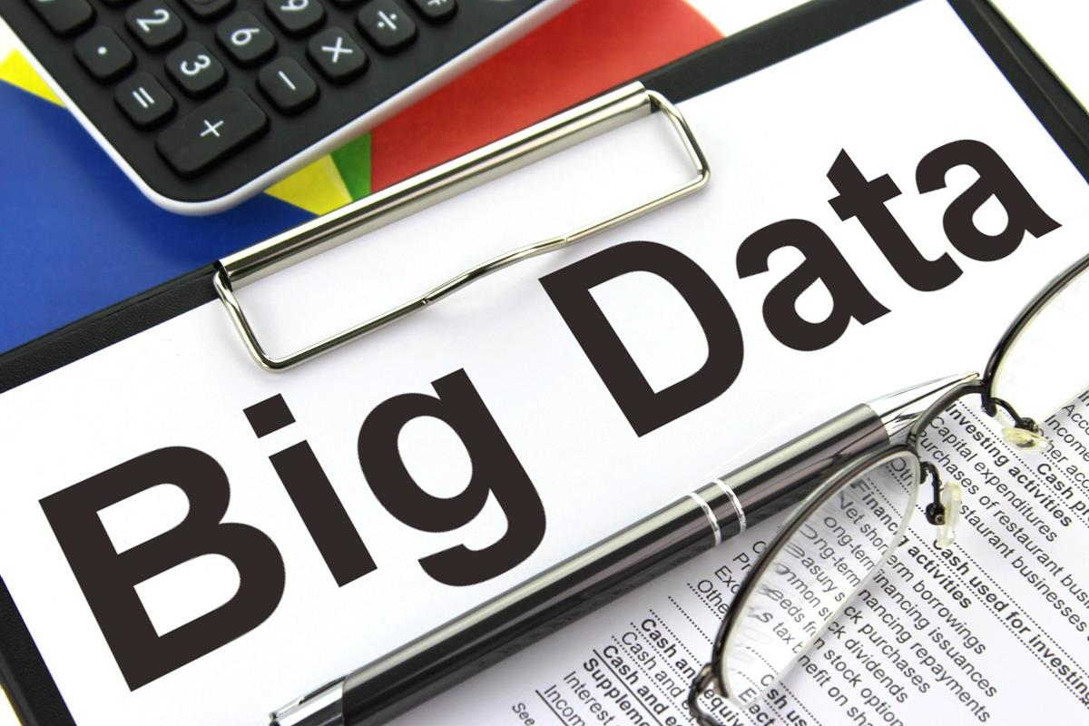
Exploratory analysis of Big Data and Cloud EDABDC
Data Models

Slide 2
Common data models
Data Model | Structure | Relationships | Use Cases | Tools
Hierarchical Data Model | Tree-like structure | Parent-child | Organizational charts, file systems | XML
Relational Data Model Entity-Relationship Model | Tables (relations) Entities and relationships | Foreign keys and primary keys One-to-one, one-to-many, many-to-many | Financial systems, inventory management Database design | SQLite Browser, MS SQL Server, MySQL, PostgreSQL, BigER vs code plugin
Document Data Model (NoSQL database) | Documents (JSON, XML) | Embedded relationships | Content management systems, web applications | MongoDB, CouchDB
Key-Value Data Model | Key-value pairs | Simple lookup | Session storage, user profiles | Redis, AWS DynamoDB

Slide 3
Common data models (Cont.)
Data Model | Structure | Relationships | Use Cases | Tools
Column-Family Data Model | Columns grouped into families | Optimized read/write operations | Time-series data, big data applications | Cassandra, HBase
Graph Data Model | Nodes and edges | Explicitly stored edges | Social networks, recommendation engines | Neo4j, OrientDB
Multi-Model Databases | Supports multiple data models | Various types | Flexible data handling, diverse use cases | ArangoDB, Couchbase

Slide 4
Importance of Data Models
Data Organization: Helps in organizing and structuring data efficiently.
Data Integrity: Ensures the accuracy and consistency of data through constraints and rules.
Data Access: Facilitates easy and efficient access to data for queries and transactions.
Scalability: Allows databases to scale and handle large volumes of data.
Maintenance: Simplifies data management and maintenance over time.

Slide 5
Common data models
Hierarchical Data Model
Relational Data Model
Document Data Model
Key-Value Data Model
Graph Data Model
Column family data model
Time series data model
Multi-Model Databases

Slide 6
Column-Family Data Model
The column-family data model is a schema design concept used in some NoSQL databases, particularly those in the wide-column store category like Apache Cassandra and HBase.
It is designed to handle large volumes of data across many commodity servers, providing high availability and scalability.

Slide 7
Key Concepts of Column-Family Data Model
Column Family:
A column family is a collection of rows, and each row is a collection of columns. It is analogous to a table in relational databases.
Column families can be thought of as containers for related data. Each column family typically contains data of a similar type or context.
Rows and Columns:
Rows: Each row has a unique identifier called a row key. Rows within a column family do not have to contain the same columns, allowing for a flexible schema.
Columns: Columns within a row are stored as a set of key-value pairs. A column can also have a timestamp to manage versions of data.

Slide 8
Key Concepts of Column-Family Data Model
Column: Columns are the basic unit of storage, consisting of a column name, a value, and optionally a timestamp.
Super Column: A super column is a special kind of column that contains a map of columns. It adds another layer of nesting and can be useful for organizing related columns together under a common key.
Wide-Column Store: In wide-column stores, columns are not predefined, meaning you can add new columns to any row at any time. This schema-less nature allows for high flexibility and adaptability in handling diverse data types.

Slide 9
Example
Imagine a database to store user information where we have a column family called UserProfile.
Column Family: UserProfile
Row Key: user123
Columns:
name: "John Doe"
email: "john.doe@example.com"
age: 30
Row Key: user456
Columns:
name: "Jane Smith"
email: "jane.smith@example.com"
address: "123 Main St"

Slide 10
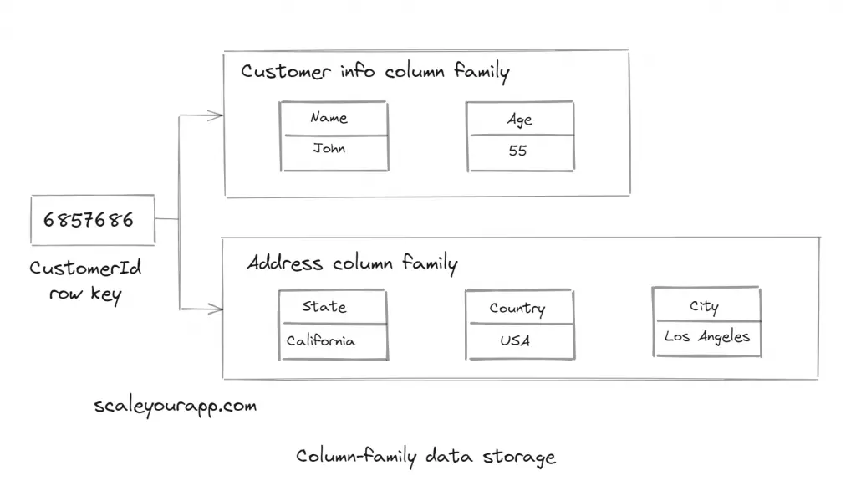

Slide 11
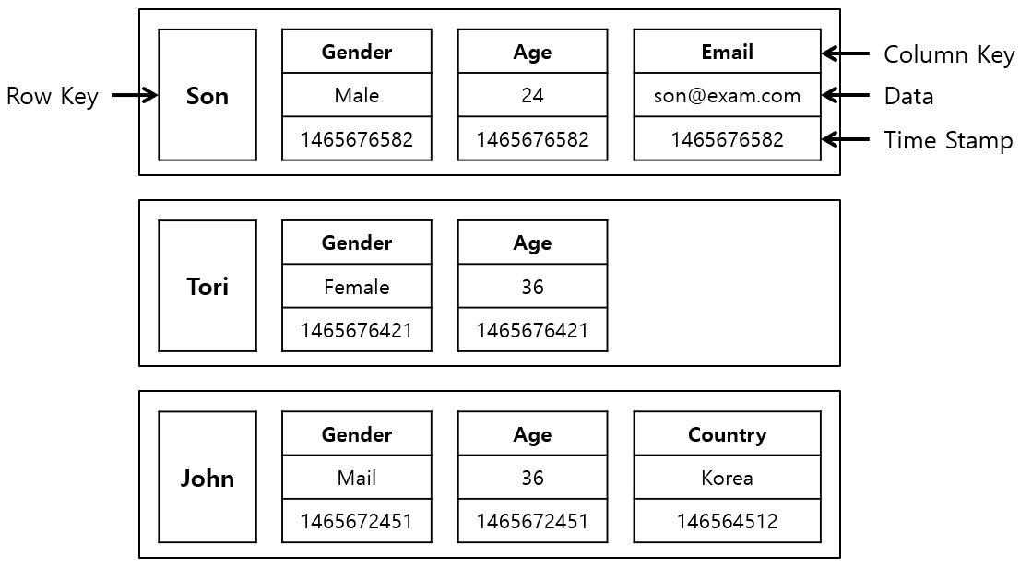

Slide 12
Row Key | Personal_Info | Contact_Info
1 | {name: "John", age: 30} | {email: "john@example.com", phone: "123-456-7890"}
2 | {name: "Jane", age: 25} | {email: "jane@example.com"}
3 | {name: "Doe"} | {email: "doe@example.com", phone: "098-765-4321", address: "123 Elm St"}

Slide 13
How Data is Structured
Data is stored in a distributed manner across multiple nodes.
Each row is identified by a unique key and can have a variable number of columns.
Columns within a row are grouped into column families, and rows within a column family do not need to have the same columns.

Slide 14
Use Cases
Time-series data: Efficiently stores and retrieves time-series data such as logs and sensor data.
Big Data applications: Handles large-scale data across distributed systems.
User profile storage: Stores dynamic user profile information with varying attribute

Slide 15
Popular Implementations
Apache Cassandra: A highly scalable, distributed database that offers high availability without compromising performance.
Apache HBase: A distributed, scalable, big data store modeled after Google's Bigtable.

Slide 16
Free tier
datastax.com

Slide 17
Common data models
Hierarchical Data Model
Relational Data Model
Document Data Model
Key-Value Data Model
Graph Data Model
Column family data model
Time series data model
Multi-Model Databases

Slide 18
Time Series Data Model
The time series data model is designed to handle sequences of data points indexed in chronological order.
This model is particularly useful for applications where tracking changes over time is crucial, such as monitoring sensor data, stock prices, weather data, and logs from systems.

Slide 19
Key Concepts of the Time Series Data Model
Time Series:
A time series is a sequence of data points, typically consisting of successive measurements made over a time interval.
Each data point in the series is associated with a timestamp.
Timestamps:
Timestamps are crucial as they indicate when the data point was recorded.
Timestamps can be at different granularity levels, such as seconds, minutes, hours, or even days.

Slide 20
Key Concepts of the Time Series Data Model
Data Points:
A data point is an observation at a particular time.
It typically consists of a timestamp and one or more associated values (e.g., temperature, humidity, price).
Tags/Labels:
Tags or labels are metadata associated with time series data.
They provide additional context or dimensions, such as location, device ID, or metric type, facilitating filtering and querying.

Slide 21
How Data is Structured
Series Key: Each time series can be identified by a unique key, often a combination of tags and metric names.
Ordered Data: Data points are stored in chronological order to optimize time-based queries.
Compression: Time series databases often use compression techniques to efficiently store large volumes of data.
Retention Policies: Time series databases typically support retention policies, automatically deleting old data based on predefined rules.
Aggregation policy: Rules and procedures used to summarize or aggregate detailed time series data into more manageable and useful forms. Aggregation is crucial for reducing the storage requirements of time series data and for enabling efficient querying and analysis

Slide 22
Example
Consider a time series database storing temperature readings from multiple sensors:
Series Key: sensor_id:12345, metric
Data Points:
2024-06-01T00:00:00Z: 25.3°C
2024-06-01T01:00:00Z: 24.8°C
2024-06-01T02:00:00Z: 24.5°C

Slide 23
Use Cases
Monitoring and Observability: System metrics, logs, and traces for monitoring applications and infrastructure.
Financial Data: Stock prices, trading volumes, and other financial metrics.
IoT Data: Sensor readings from IoT devices, including environmental data and smart home metrics.
Scientific Research: Climate data, astronomical observations, and other scientific measurements.

Slide 24
Popular Implementations
InfluxDB: A time series database known for high performance, built-in dashboarding (via Chronograf), and integration with Telegraf for metrics collection.
TimescaleDB: An extension on PostgreSQL designed for time series data, combining SQL querying capabilities with time series optimizations.
Graphite: A monitoring tool that stores time series data and provides real-time visualization.
Prometheus: A monitoring system and time series database commonly used in cloud-native environments.

Slide 25
insert data to influxdb
INSERT temperature,location=office value=22.5
INSERT temperature,location=office value=23.0
INSERT temperature,location=lab value=19.5
INSERT temperature,location=lab value=20.0

Slide 26
Common data models
Hierarchical Data Model
Relational Data Model
Document Data Model
Key-Value Data Model
Graph Data Model
Column family data model
Time series data model
Multi-Model Databases

Slide 27
Multi-model databases
Multi-model databases are a type of database management system (DBMS) designed to support multiple data models under a single integrated backend.
This allows users to store, manage, and query data in various formats using different paradigms within the same database system.

Slide 28
Key Features
Multiple Data Models: Multi-model databases support different types of data models such as:
Relational: Traditional table-based format used for structured data.
Document: JSON, BSON, or XML format used for semi-structured data.
Graph: Nodes and edges used for data with complex relationships.
Key-Value: Simple key-value pairs used for high-performance data retrieval.
Column-Family: Similar to relational but optimized for wide-column storage.
Object: Data stored as objects, similar to object-oriented programming.

Slide 29
Key Features
Unified Query Interface: Users can query data across different models using a single query language or a combination of query languages. SQL, for example, can be extended to support querying graph or JSON data.
Consistency and Transactions: Multi-model databases often support ACID (Atomicity, Consistency, Isolation, Durability) transactions across different data models to ensure data integrity.
Flexibility and Scalability: They provide flexibility in data modeling and are scalable to handle large volumes of diverse data.

Slide 30
Advantages
Consolidation: A single multi-model database can replace multiple specialized databases, simplifying the architecture and reducing maintenance overhead.
Cost Efficiency: Reduces the need for different DBMS licenses and the resources required to manage them.
Development Speed: Developers can choose the appropriate data model for each use case without needing to integrate and maintain multiple systems.
Operational Efficiency: Unified management and monitoring tools streamline operations and improve efficiency.

Slide 31
Use Cases
Enterprise Applications: Applications requiring diverse data types, such as e-commerce platforms, benefit from the flexibility of multi-model databases.
Content Management Systems: Handling varied content types (text, metadata, relationships) efficiently.
IoT Applications: Storing and processing a mix of time-series data, metadata, and device relationships.
Social Networks: Managing complex relationships and unstructured content.

Slide 32
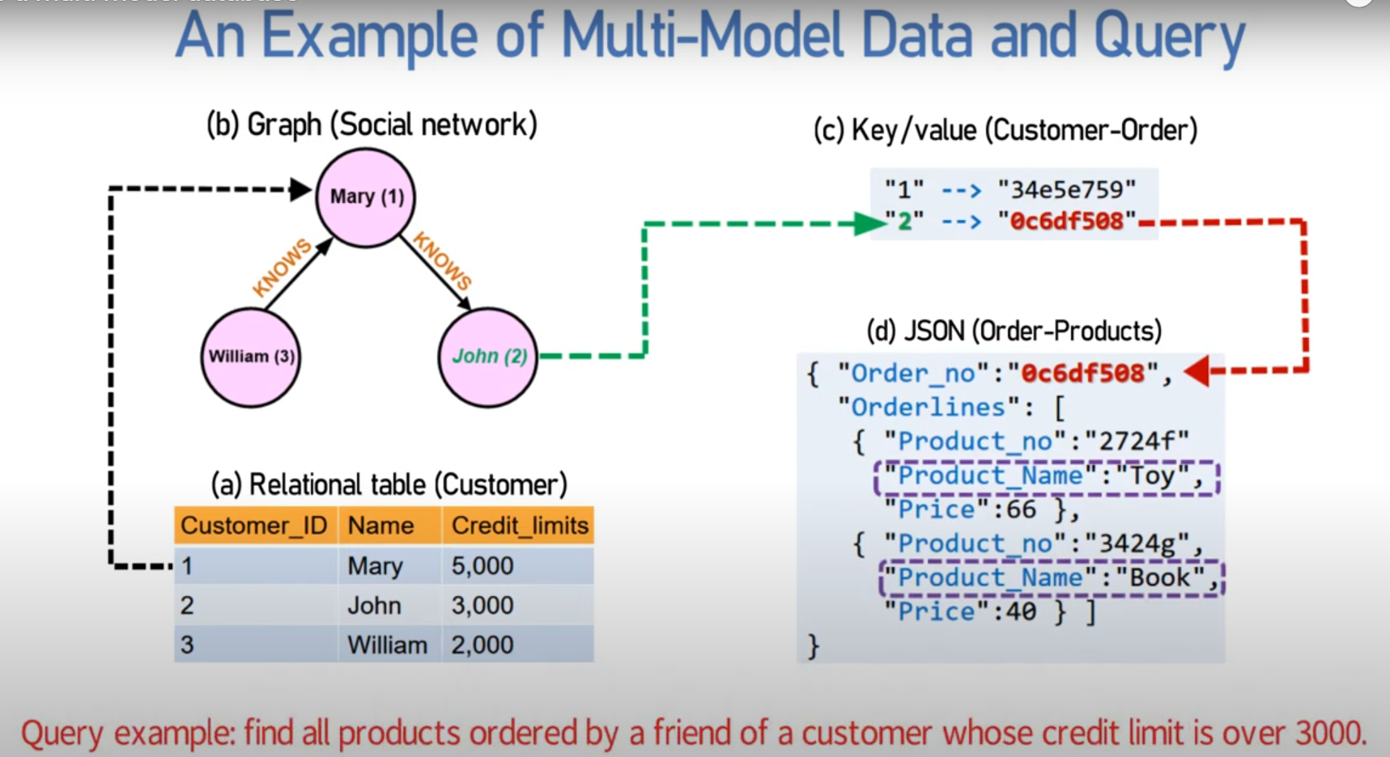








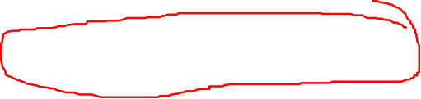

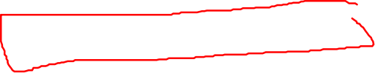


Slide 33



Examples of Multi-Model Databases
Oracle Database: Supports relational, JSON, XML, and spatial data.
ArangoDB: A native multi-model database supporting graph, document, and key-value models.
Couchbase: Supports key-value, document (JSON), and SQL++ for querying.
MarkLogic: Designed for handling XML, JSON, RDF, and other data models.
OrientDB: Supports graph, document, object, and key-value models.

Slide 34
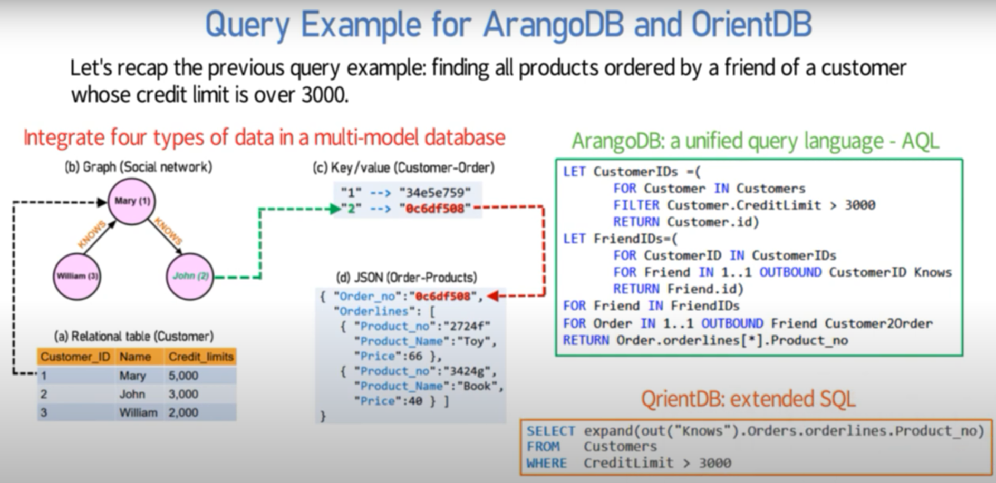
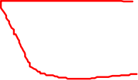
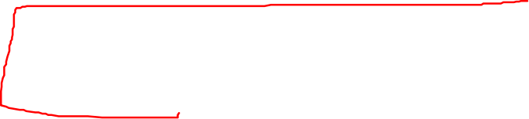

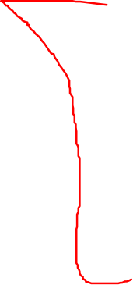

Slide 35




Some Multi-Model Databases and supported data models
Database | Supported Data Models
Oracle Database | Relational, JSON, XML, Spatial
ArangoDB | Graph, Document, Key-Value
Couchbase | Key-Value, Document (JSON), SQL++
MarkLogic | XML, JSON, RDF, Other Data Models
OrientDB | Graph, Document, Object, Key-Value

Slide 36
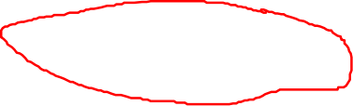
Examples of Multi-Model Databases
Azure Cosmos DB
Overview: Azure Cosmos DB is a globally distributed, multi-model database service.
Supported Models: It supports multiple data models, including document, key-value, graph, and column-family.
Amazon DynamoDB
Overview: Amazon DynamoDB is a key-value and document database that delivers single-digit millisecond performance at any scale.
Supported Models: Primarily supports key-value and document data models.

Slide 37
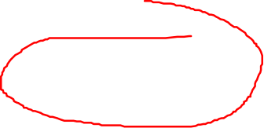


Azure and AWS Multi-Model Databases and supported data models
Service Name | Supported Data Models | Supported Data Models | Use Cases
Azure | Azure Cosmos DB | Document, Key-Value, Graph, Column-Family | E-commerce platforms, real-time analytics, IoT applications, global-scale web apps
AWS | Amazon DynamoDB | Key-Value, Document | High-traffic web applications, gaming, ad tech, mobile backends, serverless applications

Slide 38
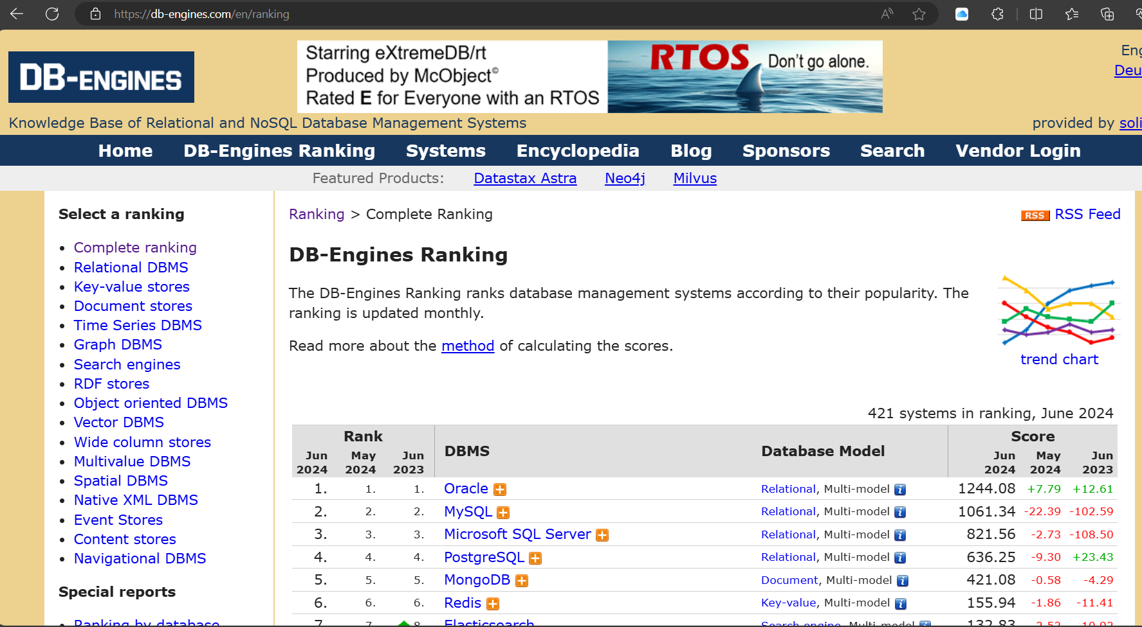




Slide 39
Recap
Multi-model databases provide a versatile and efficient solution for modern applications that require handling diverse data types.
By integrating multiple data models into a single system, they offer significant benefits in terms of consolidation, cost efficiency, and operational simplicity.
However, they also present challenges that need to be managed, particularly in terms of complexity and performance optimization

Slide 40
Data Lakes and Data warehouses
A data lake is a centralized repository that allows you to store all your structured, semi-structured, and unstructured data at any scale. Data is stored in its raw format until it is needed.
A data warehouse is a centralized repository that stores structured data from multiple sources. It is designed for query and analysis, supporting business intelligence and reporting.

Slide 41
Data Lakes and Data warehouses
Aspect | Data Lake | Data Warehouse
Data Types | Structured, semi-structured, unstructured | Structured
Schema | Schema on read | Schema on write
Purpose | Big data processing, machine learning, raw data analysis | Business intelligence, reporting, structured data analysis
Processing Frameworks | Distributed processing frameworks (e.g., Hadoop, Spark) | SQL-based querying and optimized for read performance
Storage Solutions | Inexpensive object storage (e.g., Amazon S3) | Structured storage with optimized indexing and querying capabilities

Slide 42
Common data models
Data Model | Structure | Relationships | Use Cases | Tools
Hierarchical Data Model | Tree-like structure | Parent-child | Organizational charts, file systems | XML in vs code
Relational Data Model Entity-Relationship Model | Tables (relations) Entities and relationships | Foreign keys and primary keys One-to-one, one-to-many, many-to-many | Financial systems, inventory management Database design | SQLite Browser, MS SQL Server, MySQL, PostgreSQL, BigER vs code plugin
Document Data Model (NoSQL database) | Documents (JSON, XML) | Embedded relationships | Content management systems, web applications | MongoDB, CouchDB
Key-Value Data Model | Key-value pairs | Simple lookup | Session storage, user profiles | Redis, AWS DynamoDB

Slide 43
Common data models (Cont.)
Data Model | Structure | Relationships | Use Cases | Tools
Column-Family Data Model | Columns grouped into families | Optimized read/write operations | Time-series data, big data applications | Cassandra, HBase
Graph Data Model | Nodes and edges | Explicitly stored edges | Social networks, recommendation engines | Neo4j, OrientDB
Time series data model | key series |  | stock data, climate data, IoT, .... | datastax
Multi-Model Databases | Supports multiple data models | Various types | Flexible data handling, diverse use cases | ArangoDB, Couchbase

Slide 44

Questions

